Slide 1
A Summary of Text Book Management Information System Thirteen Edition Laudon & Laudon Chapter# 1
INFORMATION SYSTEMS
in
GLOBAL BUSINESS TODAY

Slide 2
CHAPTER 1: INFORMATION IN BUSINESS SYSTEMS TODAY
Learning Objectives
Understanding the effects of information systems on business and their relationship to globalization.
Explain why information systems are so essential in business today.
Define an information system and describe its management, organization, and technology components.

Slide 3
CHAPTER 1: INFORMATION IN BUSINESS SYSTEMS TODAY
Learning Objectives (cont.)
Define complementary assets and explain how they ensure that information systems provide genuine value to an organization.
Describe the different academic disciplines used to study information systems and explain how each contributes to our understanding of them.
Explain what is meant by a sociotechnical systems perspective.

Slide 4
CHAPTER 1: INFORMATION IN BUSINESS SYSTEMS TODAY
The Role of Information Systems in Business Today
How information systems are transforming business
Increase in wireless technology use, Web sites
Increased business use of Web 2.0 technologies
Cloud computing, mobile digital platform allow more distributed work, decision-making, and collaboration
Globalization opportunities
Internet has drastically reduced costs of operating on global scale
Presents both challenges and opportunities

Slide 5
CHAPTER 1: INFORMATION IN BUSINESS SYSTEMS TODAY
The Role of Information Systems in Business Today
In the emerging, fully digital firm
Significant business relationships are digitally enabled and mediated
Core business processes are accomplished through digital networks
Key corporate assets are managed digitally
Digital firms offer greater flexibility in organization and management
Time shifting, space shifting

Slide 6
CHAPTER 1: INFORMATION IN BUSINESS SYSTEMS TODAY
The Role of Information Systems in Business Today
Growing interdependence between ability to use information technology and ability to implement corporate strategies and achieve corporate goals
Business firms invest heavily in information systems to achieve six strategic business objectives:
Operational excellence
New products, services, and business models
Customer and supplier intimacy
Improved decision making
Competitive advantage
Survival

Slide 7
CHAPTER 1: INFORMATION IN BUSINESS SYSTEMS TODAY
The Role of Information Systems in Business Today
Operational excellence:
Improvement of efficiency to attain higher profitability
Information systems, technology an important tool in achieving greater efficiency and productivity
Walmart’s RetailLink system links suppliers to stores for superior replenishment system
Retail-perakende satış, replesnihment-ikmal (yeniden yerine koyma-doldurma), excellence-üstünlük, Walmart- ABD’de perakende satış yapan mağazalar zinciri (2.5 Milyon çalışanı var)

Slide 8
CHAPTER 1: INFORMATION IN BUSINESS SYSTEMS TODAY
The Role of Information Systems in Business Today
New products, services, and business models:
Business model: describes how company produces, delivers, and sells product or service to create wealth
Information systems and technology a major enabling tool for new products, services, business models
Examples: Apple’s iPod, iTunes, iPhone, iPad, Google’s Android OS, and Netflix

Slide 9
CHAPTER 1: INFORMATION IN BUSINESS SYSTEMS TODAY
The Role of Information Systems in Business Today
Customer and supplier intimacy: (memnuniyet)
Serving customers well leads to customers returning, which raises revenues and profits
Example: High-end hotels that use computers to track customer preferences and use to monitor and customize environment
Intimacy with suppliers allows them to provide vital inputs, which lowers costs
Example: J.C.Penney’s information system which links sales records to contract manufacturer

Slide 10
CHAPTER 1: INFORMATION IN BUSINESS SYSTEMS TODAY
The Role of Information Systems in Business Today
Improved decision making
Without accurate information:
Managers must use forecasts, best guesses, luck
Leads to:
Overproduction, underproduction of goods and services
Misallocation of resources
Poor response times
Poor outcomes raise costs, lose customers
Example: Verizon’s Web-based digital dashboard to provide managers with real-time data on customer complaints, network performance, line outages, etc.

Slide 11
CHAPTER 1: INFORMATION IN BUSINESS SYSTEMS TODAY
The Role of Information Systems in Business Today
Operational excellence:
Improvement of efficiency to attain higher profitability
New products, services, and business models:
Enabled by technology
Customer and supplier intimacy:
Serving customers raises revenues and profits
Better communication with suppliers lowers costs
Improved decision making
More accurate data leads to better decisions
(profit-kar, revenue-gelir)

Slide 12
CHAPTER 1: INFORMATION IN BUSINESS SYSTEMS TODAY
The Role of Information Systems in Business Today
Competitive advantage
Delivering better performance
Charging less for superior products
Responding to customers and suppliers in real time
Examples: Apple, Walmart, UPS

Slide 13
CHAPTER 1: INFORMATION IN BUSINESS SYSTEMS TODAY
Perspectives on Information Systems
Information system:
Set of interrelated components
Collect, process, store, and distribute information
Support decision making, coordination, and control
Information vs. data
Data are streams of raw facts
Information is data shaped into meaningful form

Slide 14
CHAPTER 1: INFORMATION IN BUSINESS SYSTEMS TODAY
Perspectives on Information Systems
Three activities of information systems produce information organizations need
Input: Captures raw data from organization or external environment
Processing: Converts raw data into meaningful form
Output: Transfers processed information to people or activities that use it

Slide 15
CHAPTER 1: INFORMATION IN BUSINESS SYSTEMS TODAY
Perspectives on Information Systems
Feedback:
Output returned to appropriate members of organization to help evaluate or correct input stage
Computer/Computer program vs. information system
Computers and software are technical foundation and tools, similar to the material and tools used to build a house

Slide 16
CHAPTER 1: INFORMATION IN BUSINESS SYSTEMS TODAY
Perspectives on Information Systems
Organizational dimension of information systems
Hierarchy of authority, responsibility
Senior management
Middle management
Operational management
Knowledge workers
Data workers
Production or service workers

Slide 17
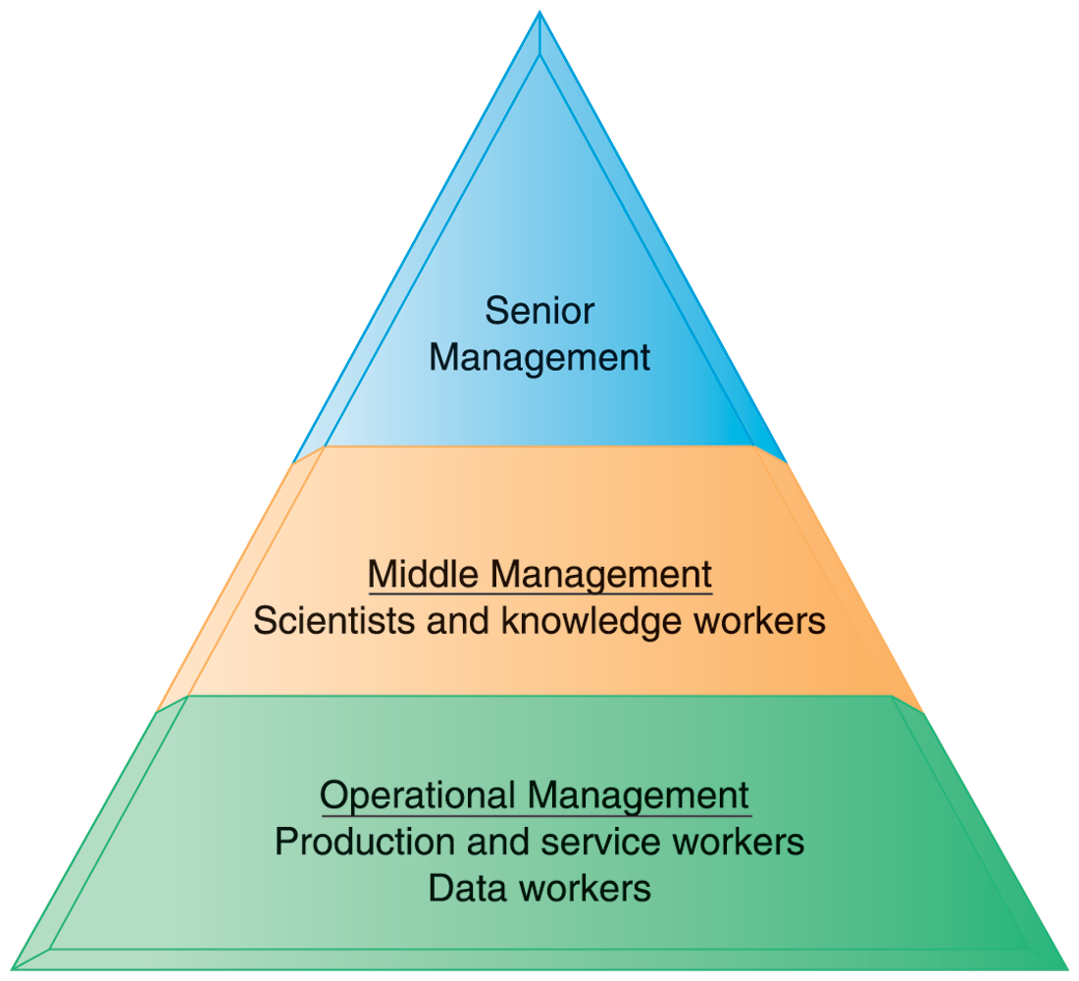
CHAPTER 1: INFORMATION IN BUSINESS SYSTEMS TODAY
Perspectives on Information Systems
Levels in a Firm
Business organizations are hierarchies consisting of three principal levels: senior management, middle management, and operational management. Information systems serve each of these levels. Scientists and knowledge workers often work with middle management.
Figure 1.6

Slide 18
CHAPTER 1: INFORMATION IN BUSINESS SYSTEMS TODAY
Perspectives on Information Systems
Organizational dimension of information systems (cont.)
Separation of business functions
Sales and marketing
Human resources
Finance and accounting
Manufacturing and production
Unique business processes
Unique business culture
Organizational politics

Slide 19
CHAPTER 1: INFORMATION IN BUSINESS SYSTEMS TODAY
Perspectives on Information Systems
Management dimension of information systems
Managers set organizational strategy for responding to business challenges
In addition, managers must act creatively:
Creation of new products and services
Occasionally re-creating the organization

Slide 20
CHAPTER 1: INFORMATION IN BUSINESS SYSTEMS TODAY
Perspectives on Information Systems
Technology dimension of information systems
Computer hardware and software
Data management technology
Networking and telecommunications technology
Networks, the Internet, intranets and extranets, World Wide Web
IT infrastructure: provides platform that system is built on

Slide 21
CHAPTER 1: INFORMATION IN BUSINESS SYSTEMS TODAY
Perspectives on Information Systems
Exemple to system organization:
Dimensions of UPS tracking system
Organizational:
Procedures for tracking packages and managing inventory and provide information
Management:
Monitor service levels and costs
Technology:
Handheld computers, bar-code scanners, networks, desktop computers, etc.
(ABD de en büyük kargo ve müşteri hizmetleri sistemi şirketi)

Slide 22
CHAPTER 1: INFORMATION IN BUSINESS SYSTEMS TODAY
Perspectives on Information Systems
Business information value chain
Raw data acquired and transformed through stages that add value to that information
Value of information system determined in part by extent to which it leads to better decisions, greater efficiency, and higher profits
Business perspective:
Calls attention to organizational and managerial nature of information systems

Slide 23
CHAPTER 1: INFORMATION IN BUSINESS SYSTEMS TODAY
The Business Information Value Chain
Information Processing Activities
Business Processes
Management Activities
Firm profitability
information systems are part of a series of value-adding activities for acquiring, transforming, and distributing information that managers can use to improve decision making, enhance organizational performance, and, ultimately, increase firm profitability.

Slide 24
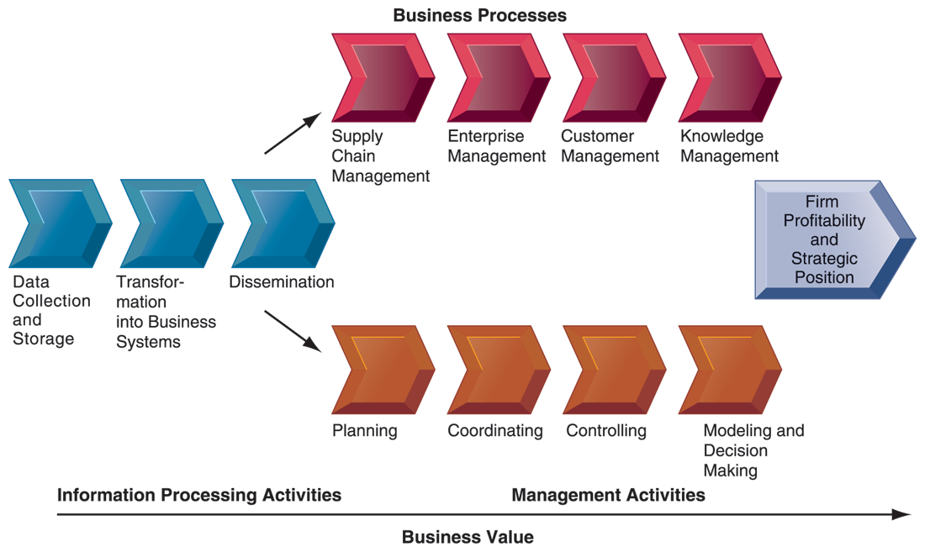
CHAPTER 1: INFORMATION IN BUSINESS SYSTEMS TODAY
The Business Information Value Chain
From a business perspective, information systems are part of a series of value-adding activities for acquiring, transforming, and distributing information that managers can use to improve decision making, enhance organizational performance, and, ultimately, increase firm profitability.

Slide 25
CHAPTER 1: INFORMATION IN BUSINESS SYSTEMS TODAY
Perspectives on Information Systems
Investing in information technology does not guarantee good returns
Considerable variation in the returns firms receive from systems investments
Factors:
Adopting the right business model
Investing in complementary assets (organizational and management capital)

Slide 26
CHAPTER 1: INFORMATION IN BUSINESS SYSTEMS TODAY
Perspectives on Information Systems
Complementary assets:
Assets required to derive value from a primary investment
Firms supporting technology investments with investment in complementary assets receive superior returns
E.g.: invest in technology and the people to make it work properly

Slide 27
CHAPTER 1: INFORMATION IN BUSINESS SYSTEMS TODAY
Perspectives on Information Systems
Tamamlayıcı nitelikler:
Complementary assets include:
Organizational assets, e.g.
Appropriate business model
Efficient business processes
Managerial assets, e.g.
Incentives for management innovation
Teamwork and collaborative work environments
Social assets, e.g.
The Internet and telecommunications infrastructure
Technology standards

Slide 28
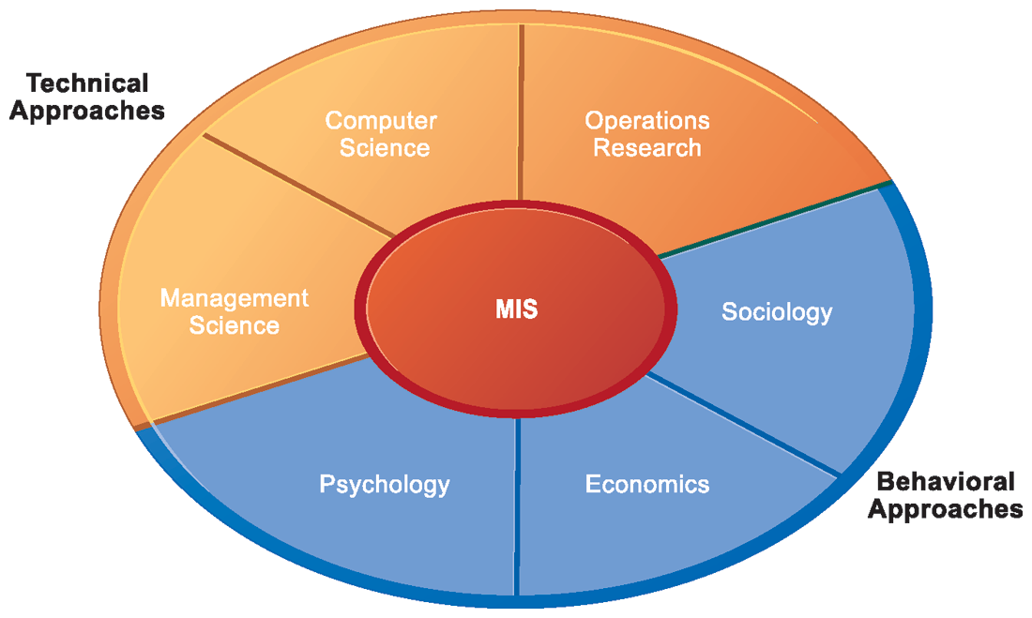
CHAPTER 1: INFORMATION IN BUSINESS SYSTEMS TODAY
Contemporary Approaches to Information Systems
Bilgi sistemine çağdaş yaklaşım
Contemporary Approaches to Information Systems
The study of information systems deals with issues and insights contributed from technical and behavioral disciplines.

Slide 29
CHAPTER 1: INFORMATION IN BUSINESS SYSTEMS TODAY
Contemporary Approaches to Information Systems
Technical approach
Emphasizes mathematically based models
Computer science, management science, operations research
Behavioral approach
Behavioral issues (strategic business integration, implementation, etc.)
Psychology, economics, sociology

Slide 30
CHAPTER 1: INFORMATION IN BUSINESS SYSTEMS TODAY
Contemporary Approaches to Information Systems
Management Information Systems
Combines computer science, management science, operations research and practical orientation with behavioral issues
Four main actors
Suppliers of hardware and software
Business firms
Managers and employees
Firm’s environment (legal, social, cultural context)

